Slide 1
Development of Machine Learning Models to Detect Arrhythmia based on ECG Data - Interpretability
Level 4 Project - 20 credit

Slide 2
Week 2
(6th Oct - 12th Oct)

Slide 3
Description of MIT-BIH Database
The MIT-BIH Arrhythmia Database contains excerpts of two-channel ambulatory ECG recordings, from 47 subjects studied by the BIH Laboratory.
23 recordings were chosen at random from a set of 4000, 24-hour ambulatory ECG recordings collected from a population 60% of inpatients and 40% outpatients.
25 recordings were selected from the same set to include less common but clinically significant arrhythmias.

Slide 4
WFDB Library for Python
The native Python waveform-database (WFDB) package. A library of tools for reading, writing, and processing WFDB signals and annotations.
Core components of this package are based on the original WFDB specifications.

Slide 5
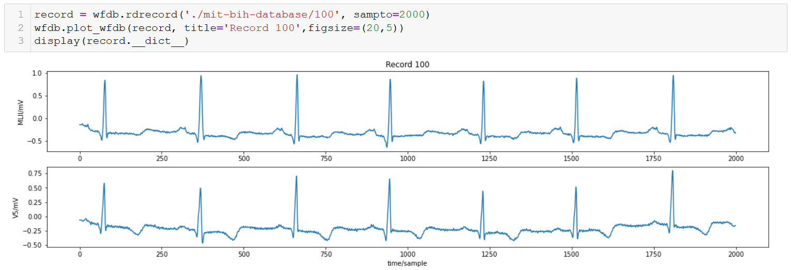
Reading Files from the Database

Slide 6
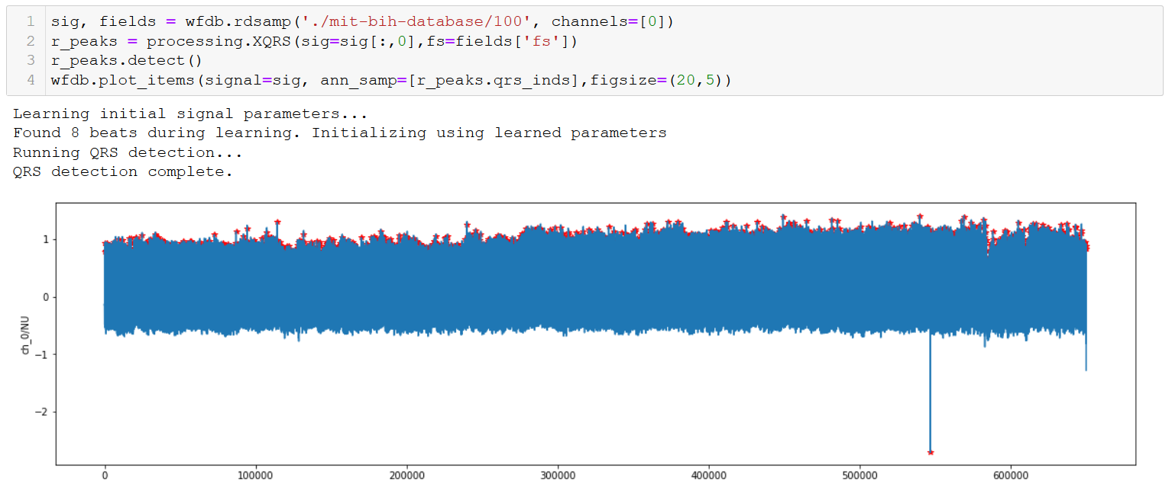
Detecting R peaks - Full Sample

Slide 7
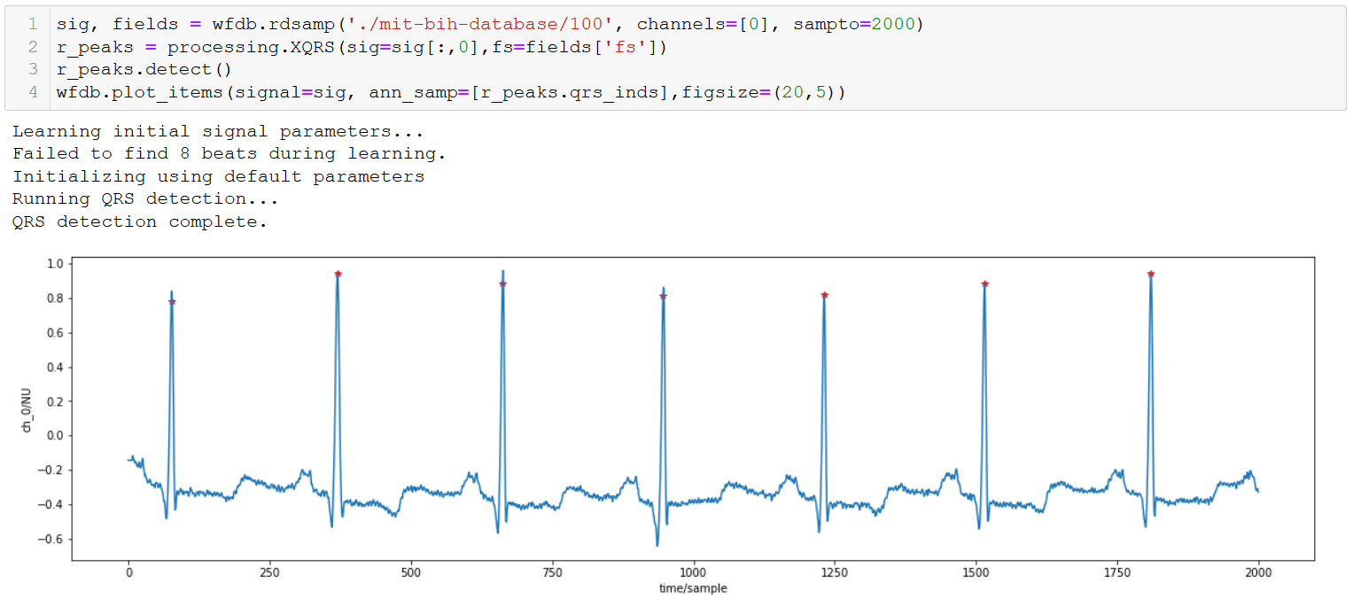
Detecting R peaks - Sample upto 2000

Slide 8
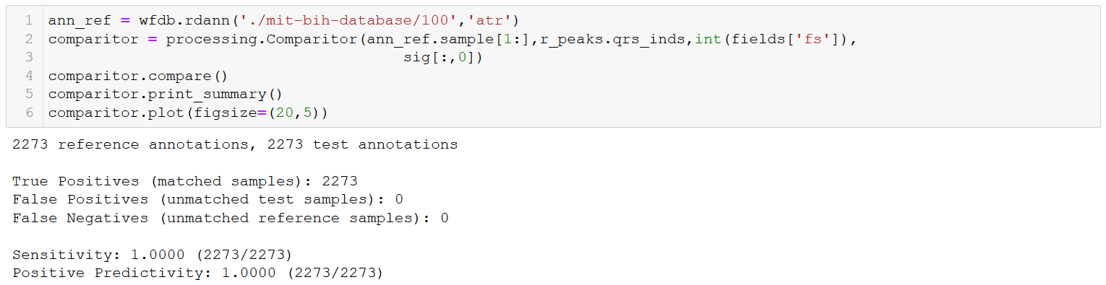
Detecting R peaks - Summary
2273 R-peaks detected for patient number 100

Slide 9
Week 2
(13th Oct - 19th Oct)

Slide 10
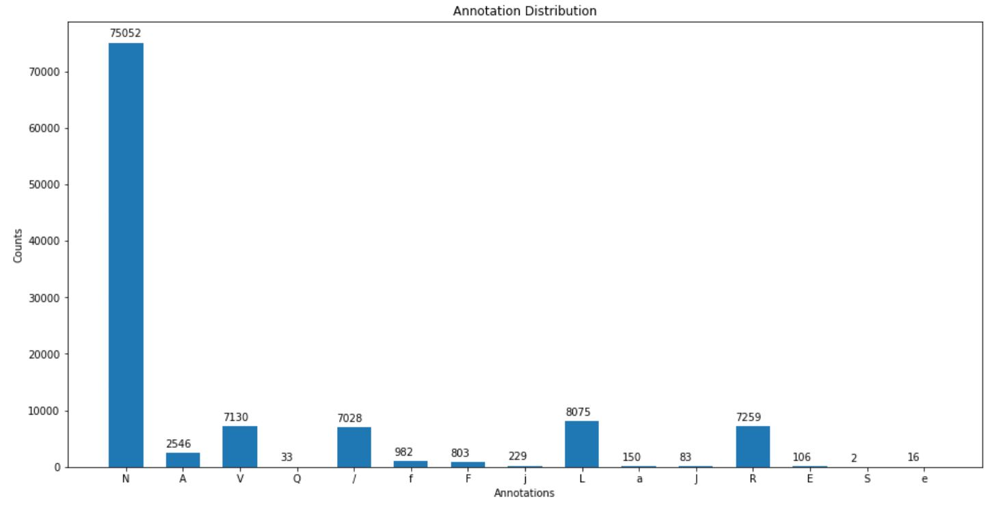
Annotation Distribution from all Records (!= 102-0)

Slide 11
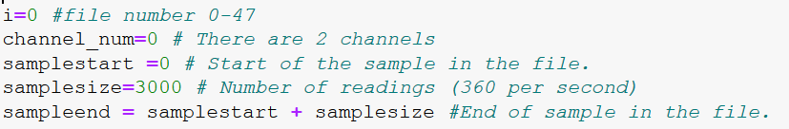
Reading all records
All records are read dynamically.
All channels are chosen dynamically.
Start, end, size of the sample can be chosen dynamically

Slide 12
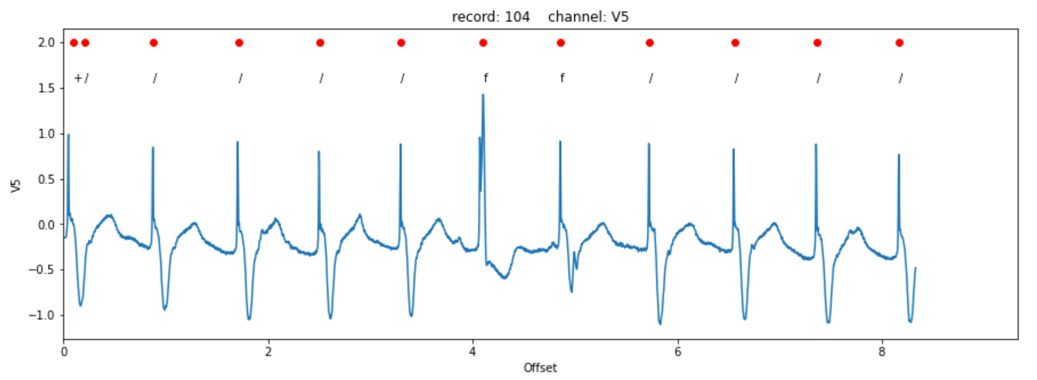
Example: Reading Record 104, Channel V5
0
1
2
3
4
5
6
Discarded

Slide 13
Data Manipulation and Storing into .csv file
Skipped first and last beat.
Acquire annotation classification values near or on R-peaks.
Only: N, L, R, V, A, F, f, /
Skipped beats with no classification.
Made the heartbeats of same length using zero padding.
Include some readings from next beat for continuation.
Normalized readings
From 0.0 to 1.0 using (beat - beat.min / beat.max - beat.min)
Or standardize using (beat - beat.mean / beat.std)
Resampling from 360Hz to 125Hz or 150Hz? *still in progress*
Segmented the ECG data, individual PQRST waves.
Store into separate .csv files per record.
Will store all data into a single one later.

Slide 14
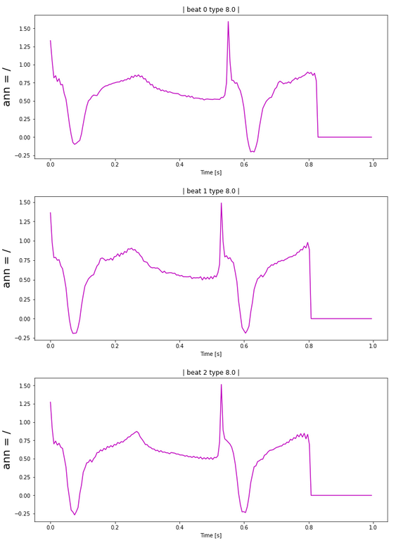
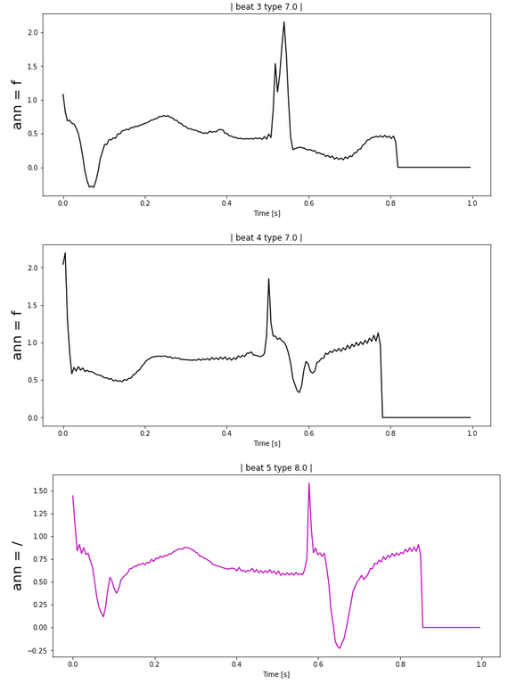
Segmented ECG Data per Beat of record: 104_V5
0
3
1
4
2
5

Slide 15
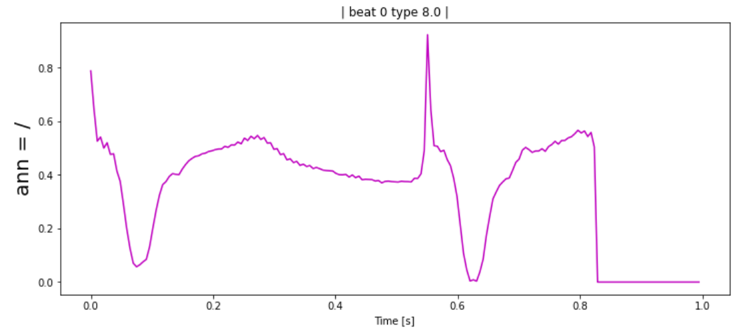
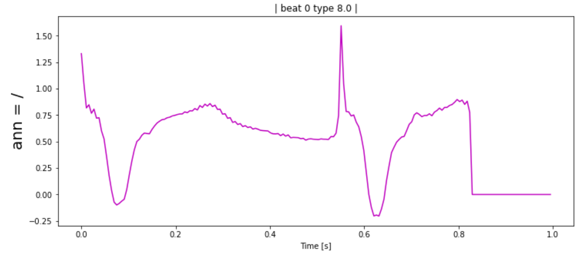
Norm/Stand Example of 104_V5, Beat: 0, Ann: /
Normalized
(beat - beat.min / beat.max - beat.min)
Standardized
(beat - beat.mean / beat.std)

Slide 16
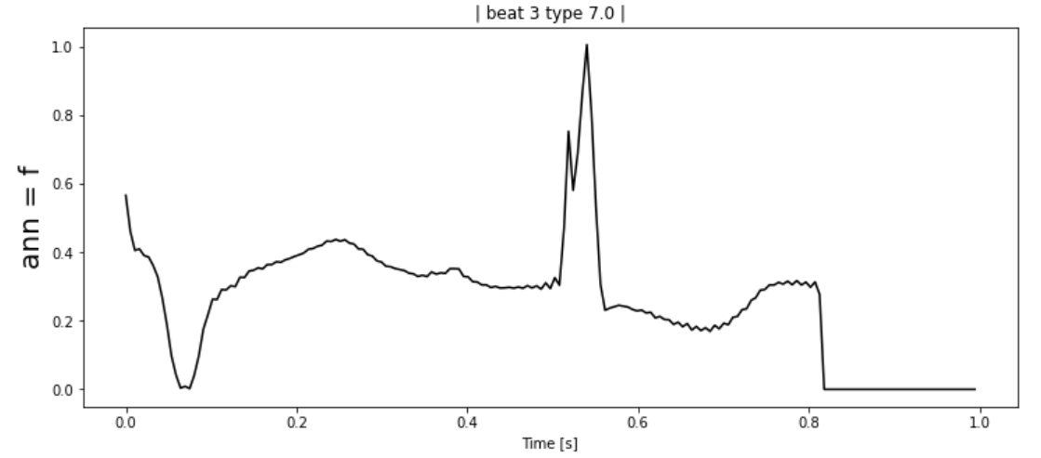
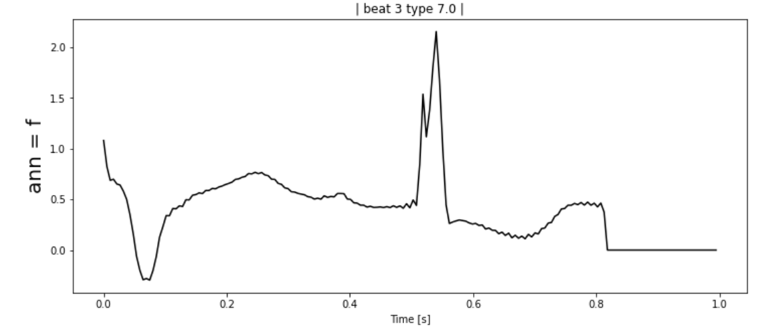
Norm/Stand Example of 104_V5, Beat: 3, Ann: f
Normalized
(beat - beat.min / beat.max - beat.min)
Standardized
(beat - beat.mean / beat.std)

Slide 17
For next week:
Create protocols to split data for training, validation, testing.
Principal Component Analysis. What to do?

